Slide 1
HTTP JSON API Node.js Time Server

Slide 2
Abstract
This project focuses on the implementation of an HTTP JSON API time server using Node.js. The objective is to create a lightweight and efficient solution for retrieving time data over HTTP in JSON format. The server responds to client requests with the current date and time formatted as JSON. The project utilizes Node.js built-in net module to create a TCP server, handling incoming connections and sending HTTP responses with the current time data. The implementation includes functions for formatting the time data and setting up the server. The project aims to provide a simple yet effective solution for integrating time functionality into various applications and systems.

Slide 3
Acknowledgment
I would like to express my gratitude to Dr. Chang, Henry for his guidance and support throughout the development of this project. Additionally, I extend my thanks to the developers of Node.js and the various libraries used in this project for their valuable contributions to the open-source community.

Slide 4
Table of Content
Introduction
Design
Implementation
Test
Enhancement Ideas
Conclusion
Reference

Slide 5
Introduction
Objective: Implement an HTTP JSON API time server using Node.js.
Motivation: Modern applications demand efficient time data retrieval mechanisms, prompting exploration of lightweight solutions.
Problems: Traditional approaches are complex and resource-intensive, hindering widespread adoption and interoperability.
Purpose: Provide lightweight time data retrieval over HTTP.
Approach: Use Node.js ‘net’ module for server creation.
Features: Respond with current time in JSON format.
Benefits: Easy integration into various applications.

Slide 6
Design
Identification of Problems:
Complexity: Traditional time server implementations can be complex, requiring extensive configuration and management.
Resource Intensiveness: Some solutions may consume significant system resources, leading to scalability issues.
Interoperability: Lack of standardized interfaces can hinder interoperability with different client applications.

Slide 7
Design
Investigation and Possible Solutions:
Simplicity: The chosen approach prioritizes simplicity to ensure ease of implementation and maintenance.
Efficiency: Leveraging Node.js asynchronous I/O model helps optimize resource usage and improve scalability.
Standardization: Using HTTP and JSON for data exchange ensures compatibility with a wide range of client applications.

Slide 8
Design
Theoretical Comparison and Selection:
Traditional Time Servers: While traditional time servers offer robust functionality, they often require complex setup and management, making them less suitable for lightweight applications.
Node.js Implementation: Node.js provides a lightweight, event-driven environment ideal for building efficient servers. Its non-blocking I/O model enhances scalability and responsiveness.
HTTP/JSON Interface: Adopting HTTP and JSON ensures compatibility and ease of integration with various client applications, addressing interoperability concerns.

Slide 9
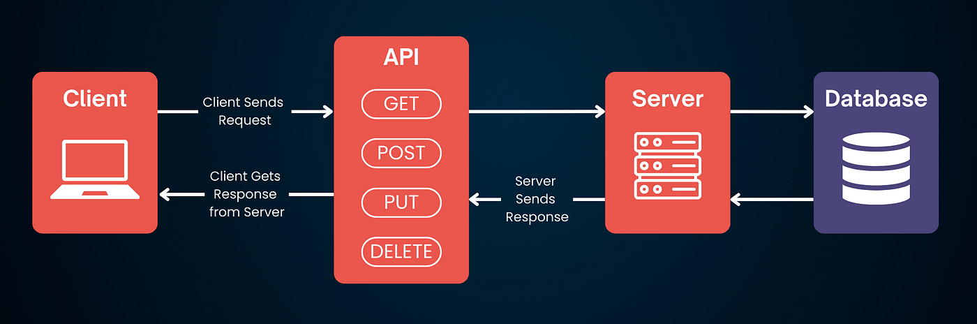
Design
It is a simple Client-Server Model:
The client, likely a web browser or another application, sends an HTTP GET request to the Node.js server.
The server, implemented using Node.js and the HTTP module, receives and processes the incoming request.
Upon processing the request, the server generates a JSON-formatted response containing current time data.
Finally, the server sends this JSON response back to the client.

Slide 10
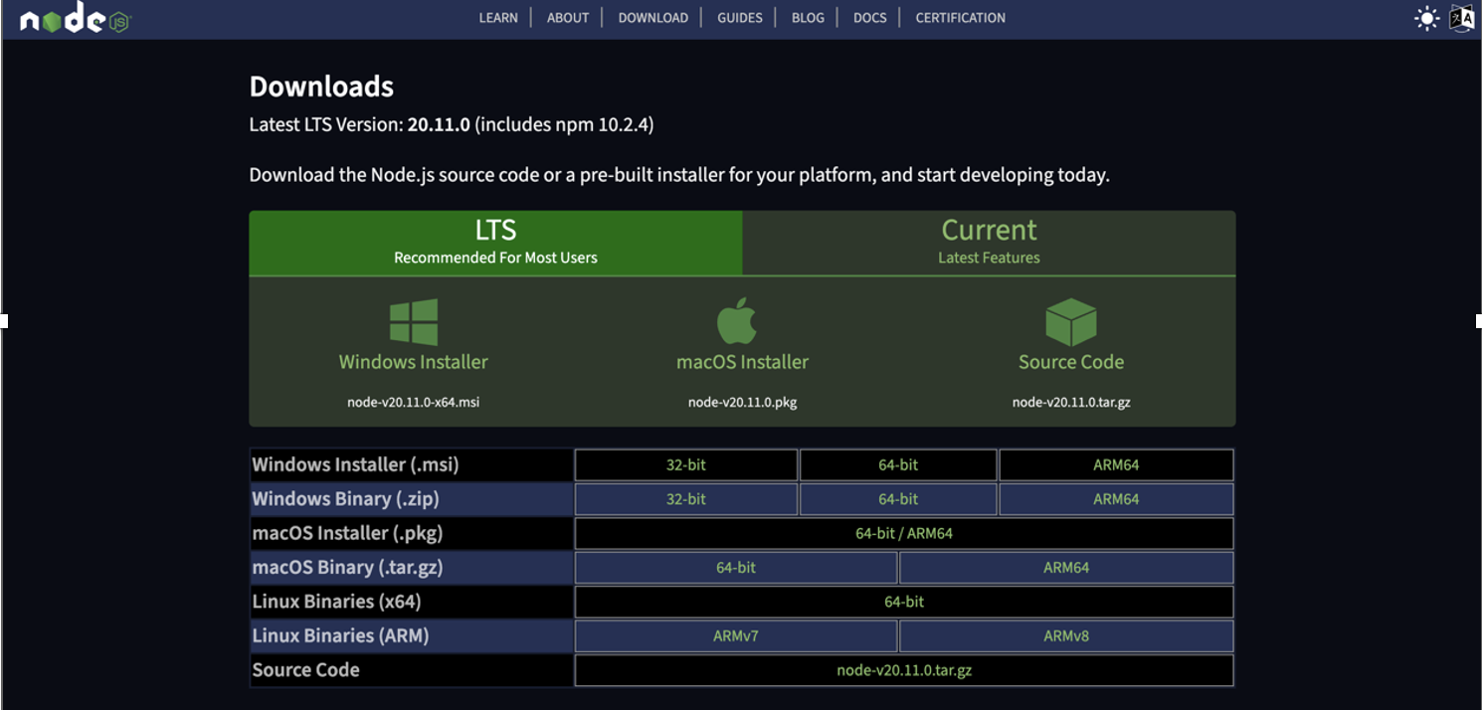
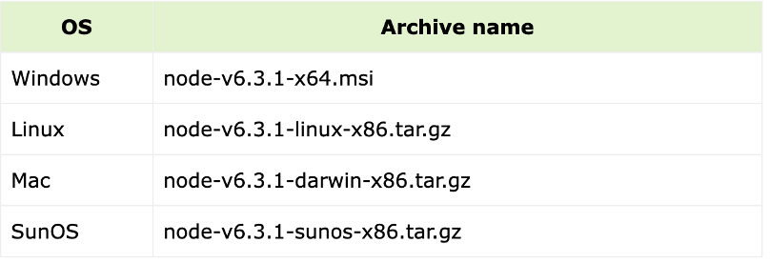
Implementation
Step 1. Download and install the appropriate version of node.js as shown in figures. Here is the link https://nodejs.org/en/download/

Slide 11

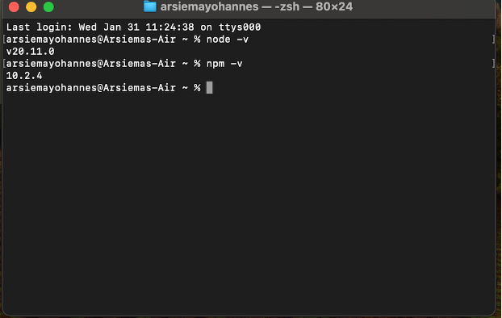
Implementation
Step 2. Check the version of node and nmp using the following code on Terminal. Just to make sure you got the right versions.

Slide 12

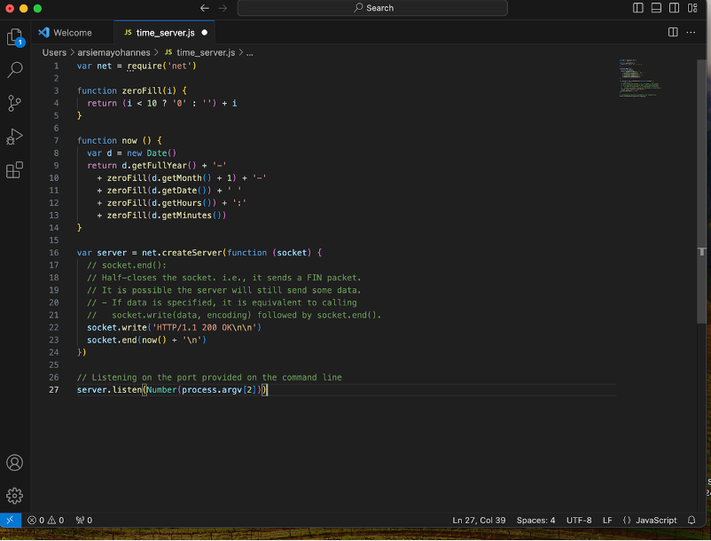
Implementation
Step 3. Create a .js file with appropriate name. You can use an IDE/Text Editor like Visual Studio Code to save file with .js extension.
The code shown
Creates a TCP server using the net module in Node.js.
Defines a function now() to get the current date and time in a specific format. "YYYY-MM-DD hh:mm"

Slide 13
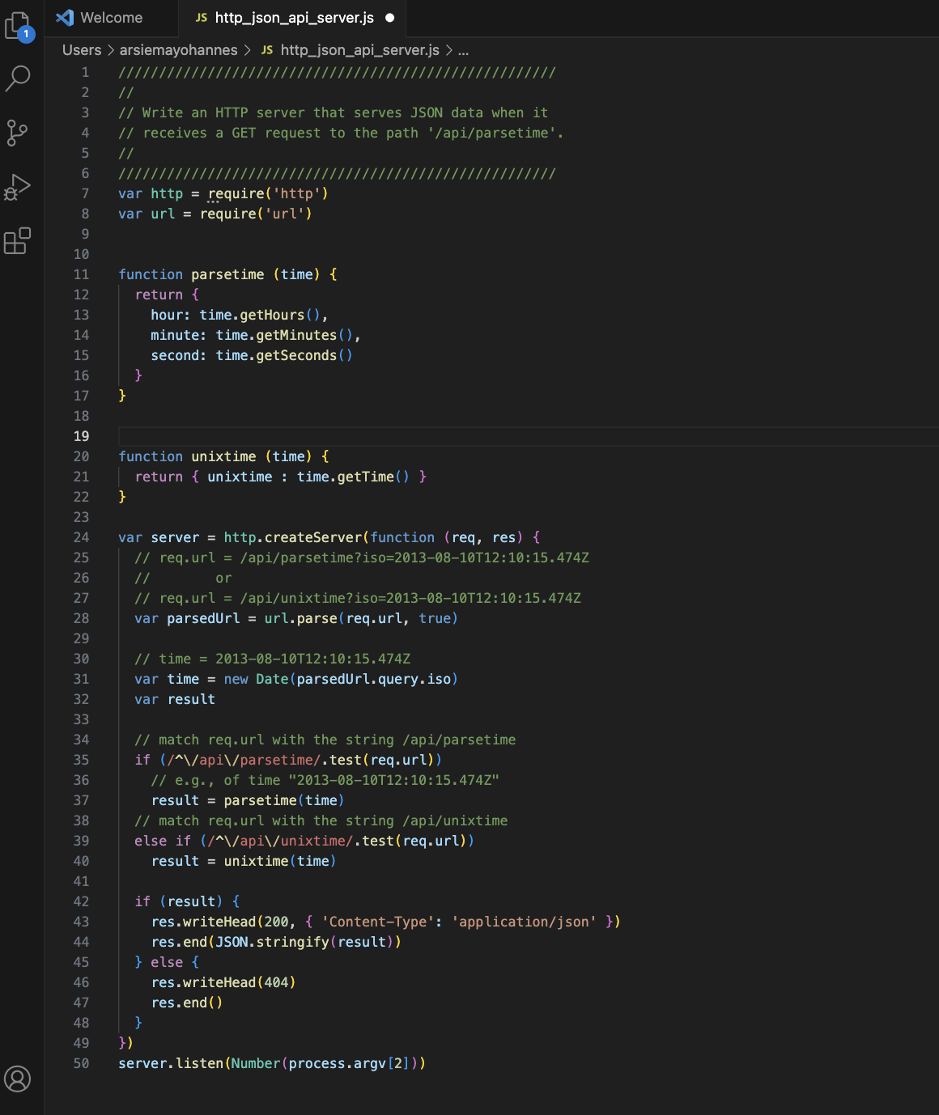
Node.js HTTP server.
Handles GET requests to '/api/parsetime' and '/api/unixtime'.
Expects 'iso' key in query string with ISO-format time.
'/api/parsetime': Returns JSON with 'hour', 'minute', and 'second'.
'/api/unixtime': Returns JSON with UNIX epoch time.

Slide 14
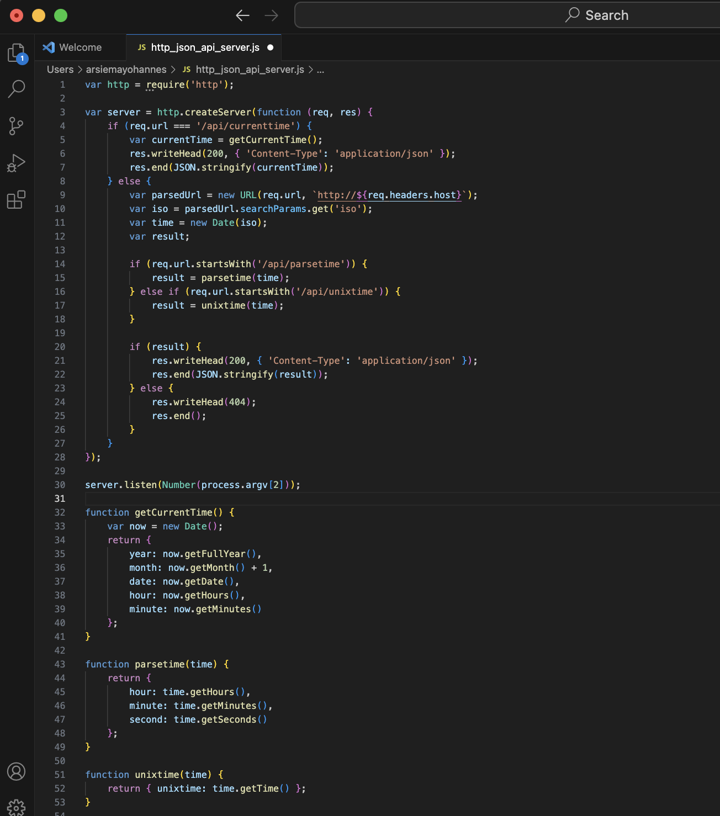
The code is similar to the one before this but, it support this request “http://localhost:8000/api/currenttime” from client side.
The primary difference between the two scripts is the addition of the /api/currenttime endpoint in the second script.

Slide 15
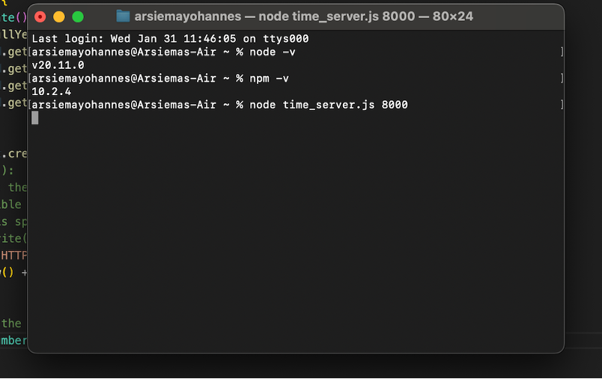
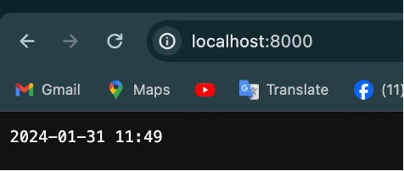
Test
Go back to terminal and write node Filename.js to run it.
Here is the output for the time_server.js when you go to http//:localhost:8000.

Slide 16
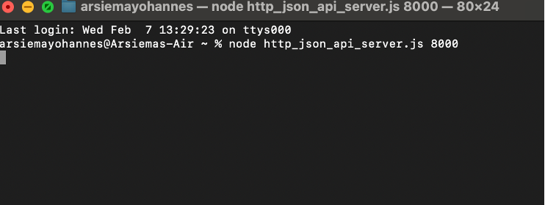
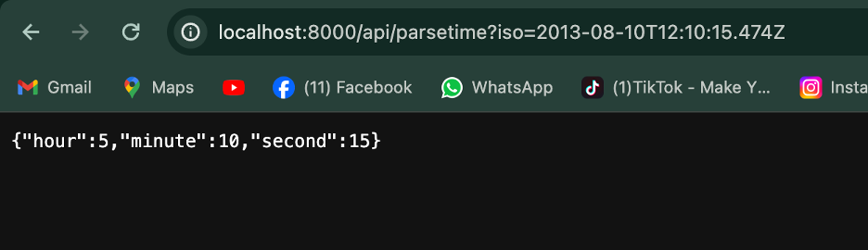
Test
Here is the output for the http_json_api_server.js when you go to the link http://localhost:8000/api/parsetime?iso=2013-08-10T12:10:15.474Z

Slide 17
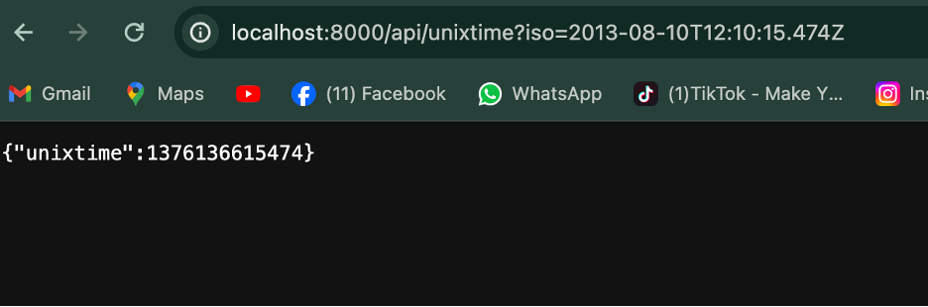
Test
Here is the output for the http_json_api_server.js when you go to http://localhost:8000/api/unixtime?iso=2013-08-10T12:10:15.474Z.

Slide 18
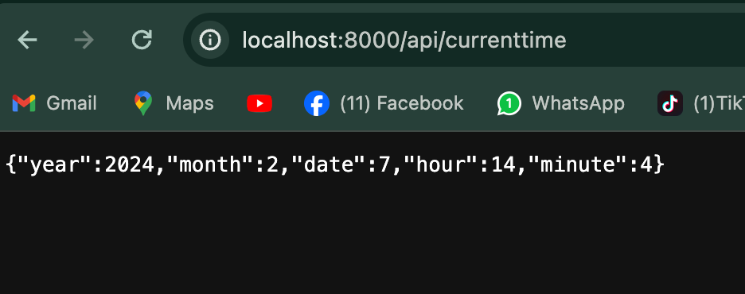
Test
Here is the output for the http_json_api_server.js when you go to http://localhost:8000/api/currenttime

Slide 19
Enhancement Ideas
If the project were to continue, several enhancements could be considered to further improve functionality and usability:
Time Zone Support: Implement functionality to allow clients to specify desired time zones for time data retrieval, providing greater flexibility for users in different regions.
Error Handling: Enhance error handling mechanisms to provide informative responses to clients in case of invalid requests or server errors, improving overall reliability.

Slide 20
Conclusion
This project aimed to develop an HTTP JSON API time server using Node.js to provide lightweight time data retrieval over HTTP. Key objectives included simplicity, efficiency, and interoperability. By leveraging Node.js's event-driven architecture and adopting HTTP/JSON interfaces, the project successfully addressed these objectives.

Slide 21
Reference
Sending HTTP requests as JSON or form with node.js and typescript. YouTube. (2019, December 28). https://youtu.be/91F0Y2cO8dc?si=D48-X3TeVvos9Ltc
Node.js HTTP module. (n.d.). https://www.w3schools.com/nodejs/nodejs_http.asp

Slide 22
Thank you

